Slide 1
Develop a telegram bot for converting images to text
U. Bharadwaj Varma
2100031737
CSC

Slide 2
Services used
S3 Bucket
Lambda
Dynamo DB
API Gateway
IAM Role

Slide 3
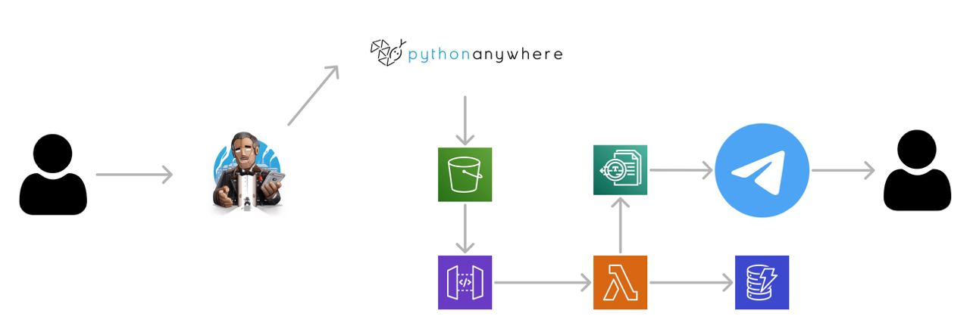
Outline of the project-

Slide 4
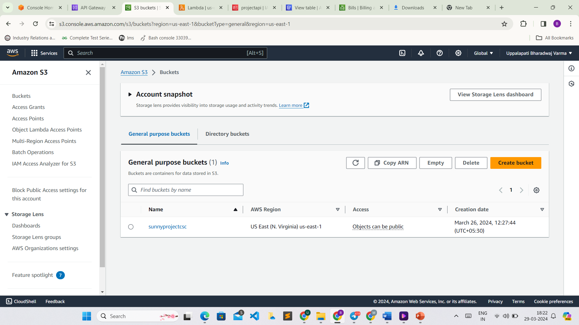
S3 Bucket-
An Amazon S3 bucket is a storage container in the cloud provided by Amazon Web Services (AWS). It is used to store objects, which can be files or any other type of data. S3 buckets are highly scalable, secure, and durable, making them ideal for storing a wide variety of data types, from images and videos to backups and log files.

Slide 5
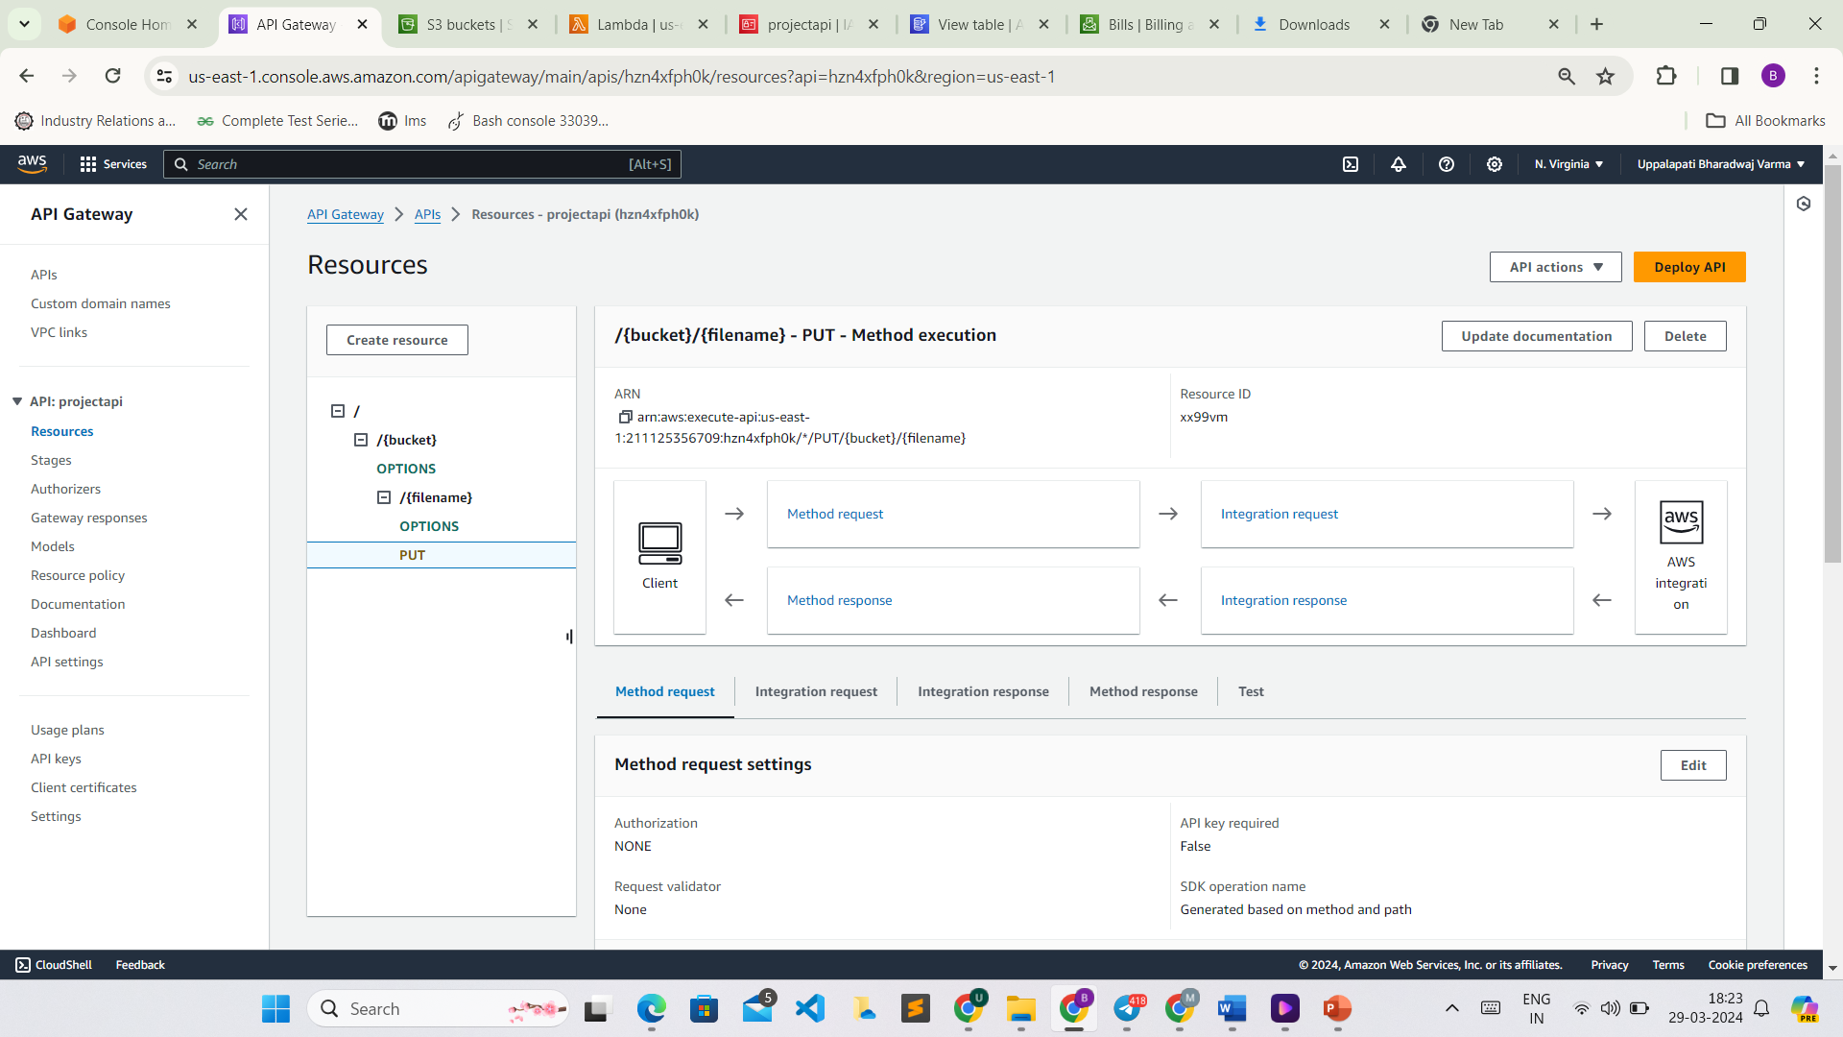
API Gateway-
API Gateway is a fully managed service from AWS that makes it easy for developers to create, publish, maintain, monitor, and secure APIs at any scale. It acts as a front door for applications to access data, business logic, or functionality from backend services, such as Lambda functions, DynamoDB tables, or EC2 instances.

Slide 6
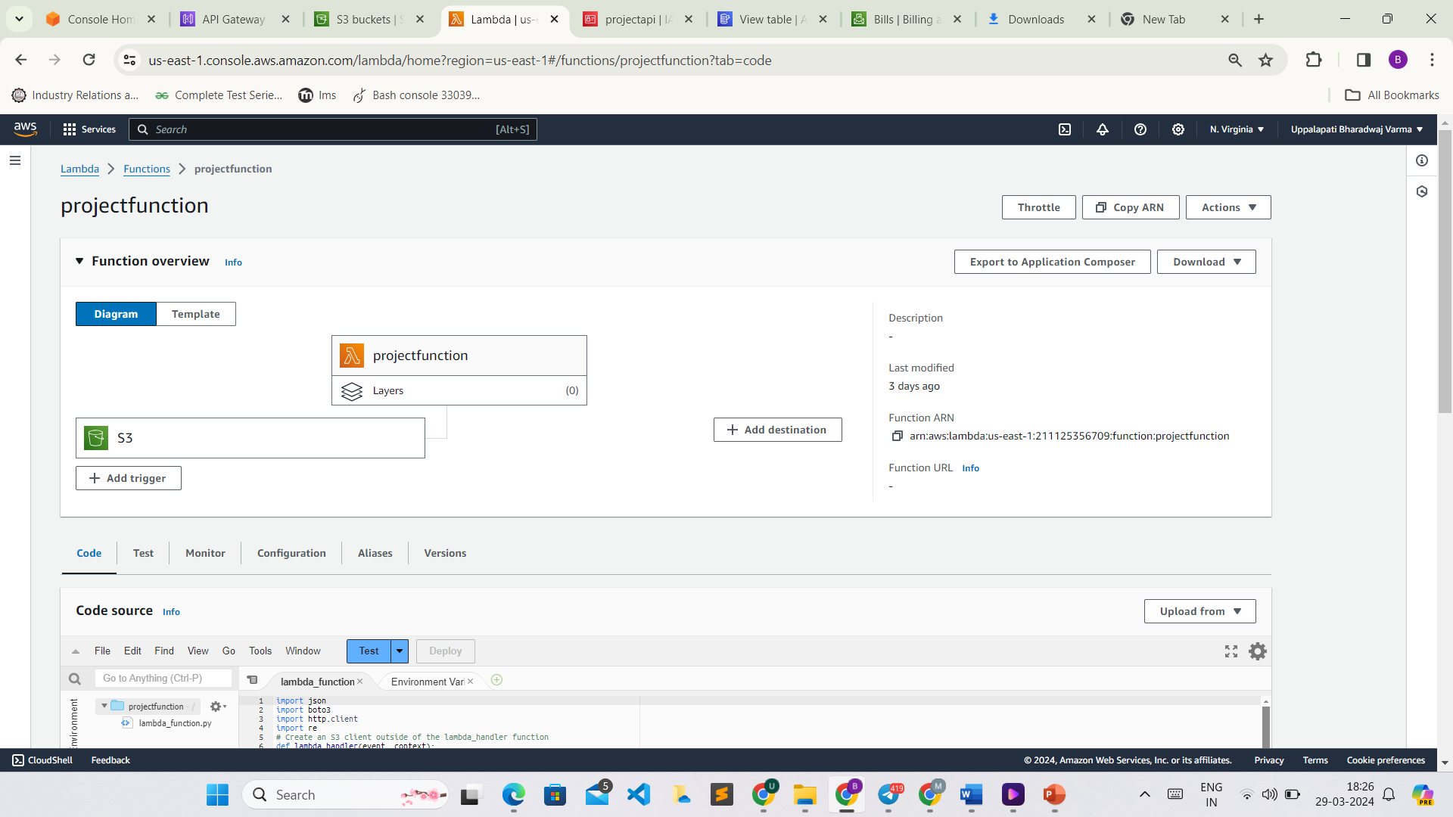
LAMBDA-
AWS Lambda is a serverless computing service that lets you run code without provisioning or managing servers. You can upload your code (written in languages like Node.js, Python, Java, or C#) and Lambda runs your code in response to events, such as changes to data in an S3 bucket, updates to a DynamoDB table, or HTTP requests through API Gateway.

Slide 7
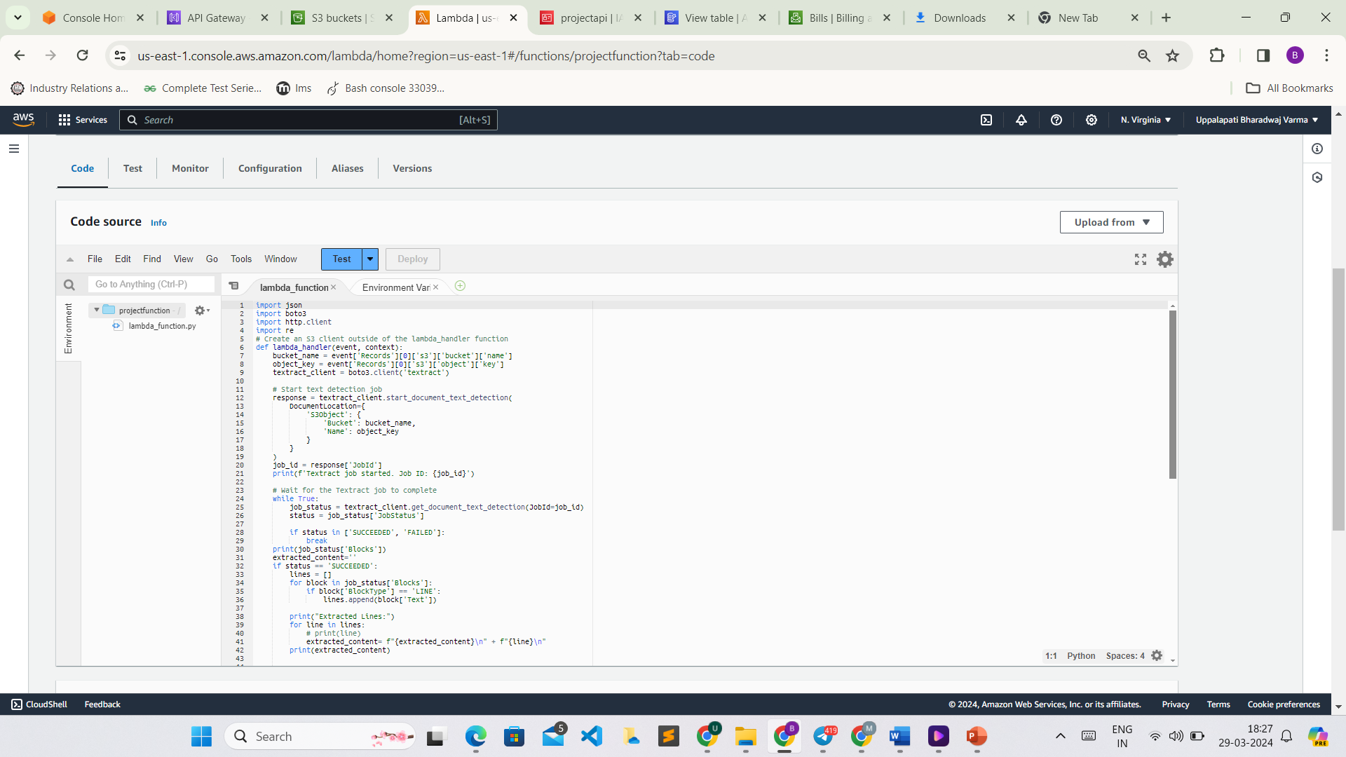
CODE-

Slide 8
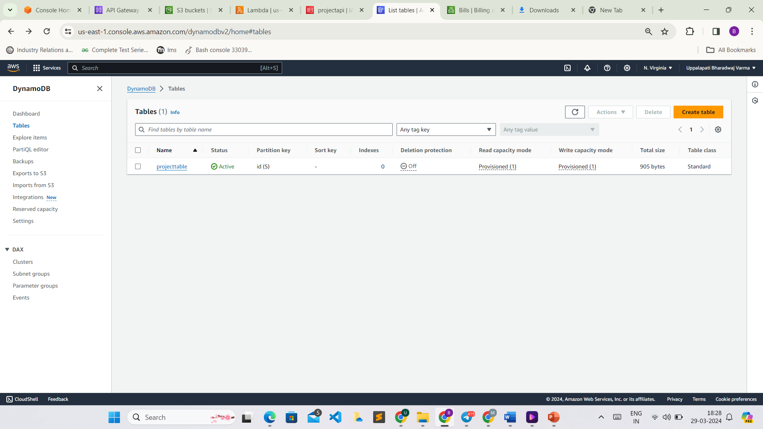
Dynamo DB-
Amazon DynamoDB is a fully managed NoSQL database service provided by AWS. It offers fast and predictable performance with seamless scalability. DynamoDB is designed to handle large amounts of data and can serve applications that require single-digit millisecond latency.

Slide 9
The Output-

Slide 10
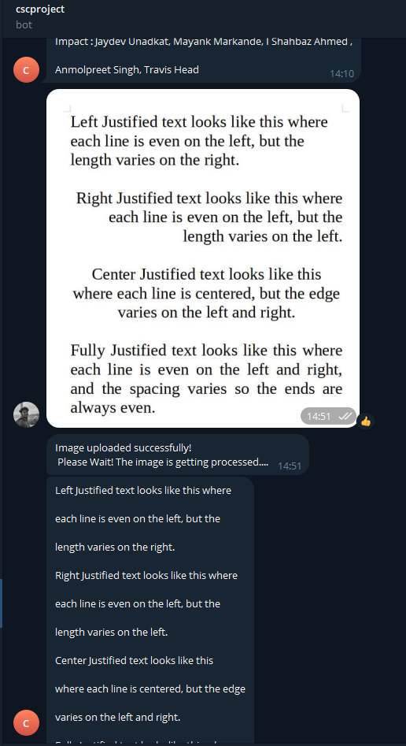

Slide 11
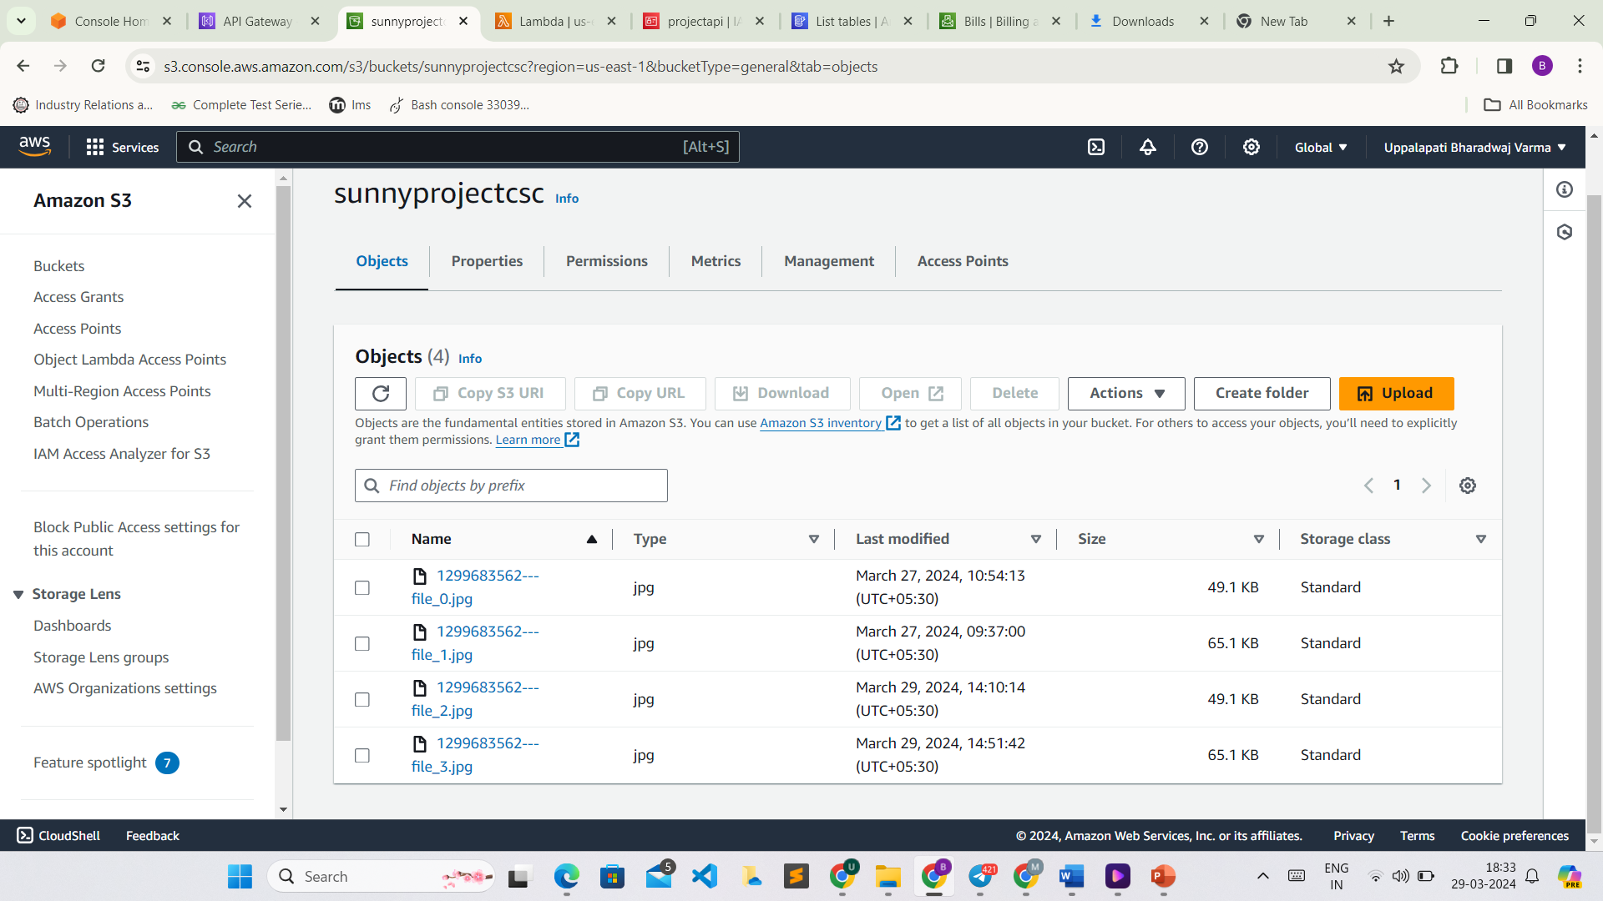
Images are stored in s3

Slide 12
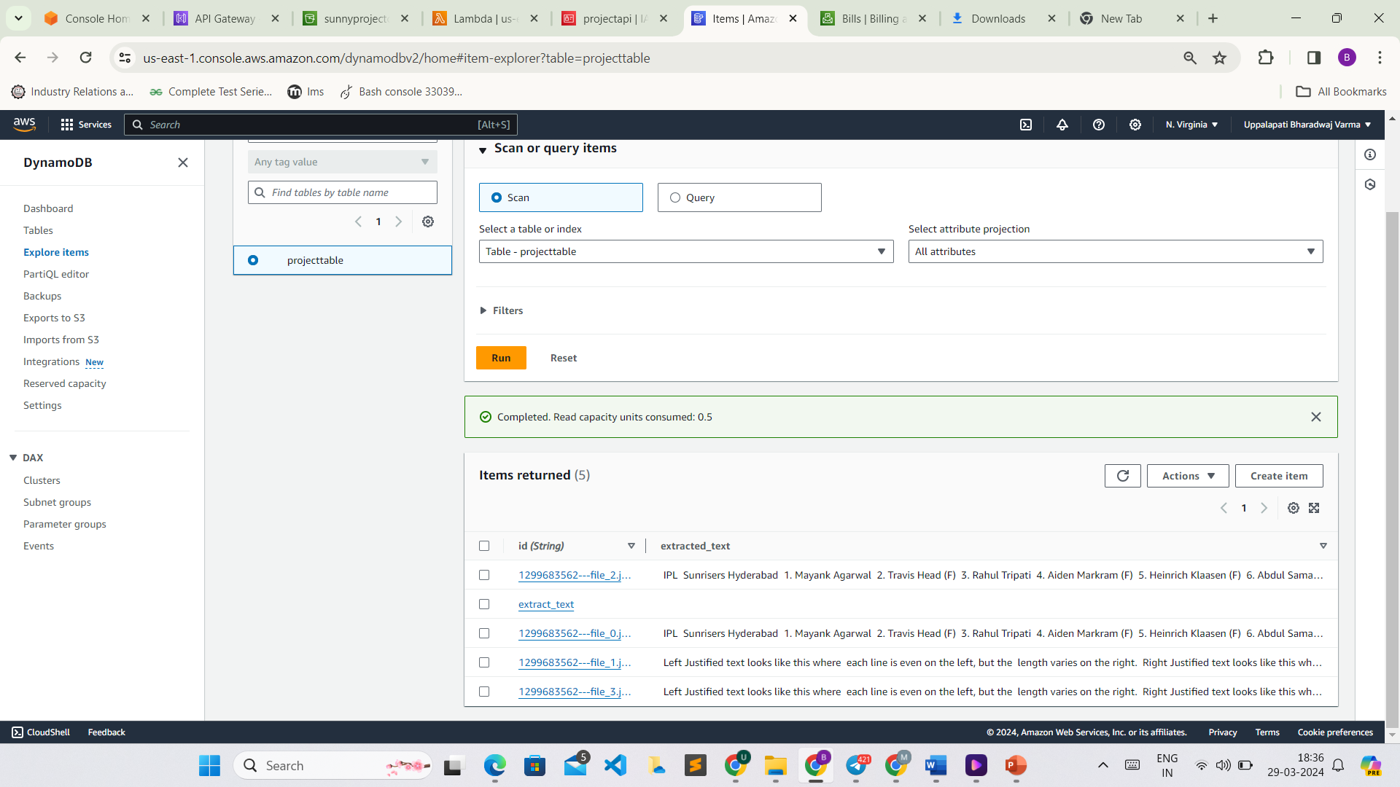
Text is stored in DynamoDB

Slide 13
Thank you

